Slide 1
CUDA
(Compute Unified Device Architecture)

Slide 2
What is CUDA?
  CUDA is a set of developing tools to create applications that will perform execution on GPU (Graphics Processing Unit).
  CUDA compiler uses variation of C with future support of C++
  CUDA was developed by NVidia and as such can only run on NVidia GPUs of G8x series and up.
  CUDA was released on February 15, 2007 for PC and Beta version for MacOS X on August 19, 2008.

Slide 3

Graphical Processing Unit
A single GPU consists of large number of cores – hundreds of cores.
Whereas a single CPU can consist of 2, 4, 8 or 12 cores
Cores? – Processing units in a chip sharing at least the memory and L1 cache

Slide 4

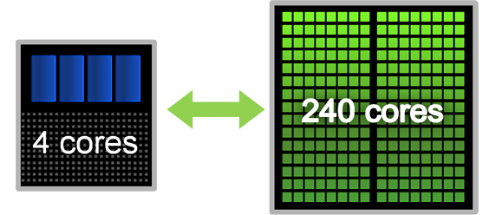
Typically GPU and CPU coexist in a heterogeneous setting
“Less” computationally intensive part runs on CPU (coarse-grained parallelism), and more intensive parts run on GPU (fine-grained parallelism)
NVIDIA’s GPU architecture is called CUDA (Compute Unified Device Architecture) architecture, accompanied by CUDA programming model, and CUDA C language

Slide 5

Programming language for threaded parallelism for GPUs
Minimal extension of C
A serial program that calls parallel kernels
Serial code executes on CPU
Parallel kernels executed across a set of parallel threads on the GPU
Programmer organizes threads into a hierarchy of thread blocks and grids

Slide 6

cudaMalloc – for allocating memory in device
cudaMemCopy – for copying data to allocated memory from host to device, and from device to host
cudaFree – freeing allocated memory
void syncthreads__() – synchronizing all threads in a block like barrier

Slide 7

Copy data from CPU to GPU
Compute on GPU
Copy data back from GPU to CPU
By default, execution on host doesn’t wait for kernel to finish
General rules:
  Minimize data transfer between CPU & GPU
  Maximize number of threads on GPU

Slide 8

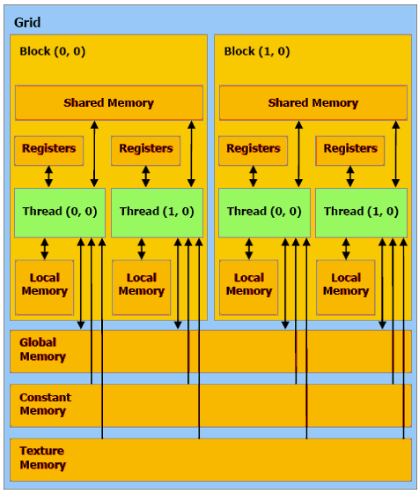

Slide 9
Parallel Sorting Algorithms

Slide 10
Odd-Even Mergesort
Uses odd-even merge algorithm that merges two sorted lists into one sorted list.

Slide 11
Odd-Even Transposition Sort
■ Variation of bubble sort.
■ Operates in two alternating phases, even phase and odd phase.
■ Even phase
■ Even-numbered processes exchange numbers with their right neighbor.
■ Odd phase
■ Odd-numbered processes exchange numbers with their right neighbor

Slide 12
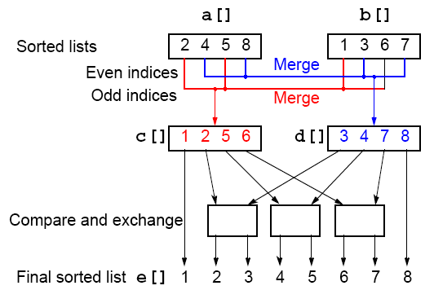
Odd-Even Merging of Two Sorted Lists

Slide 13
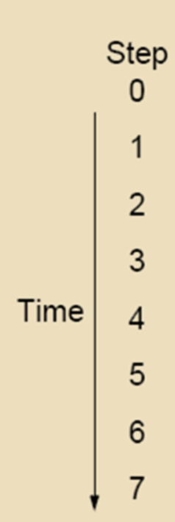
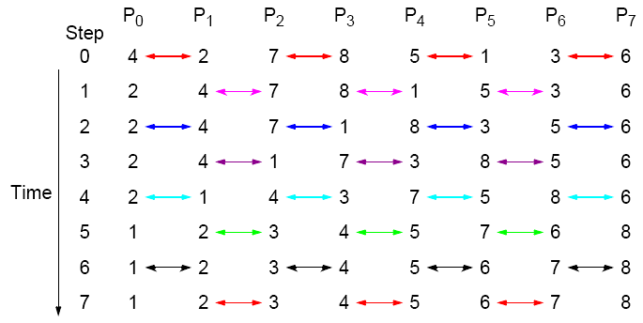
Odd-Even Sort - example
Parallel time complexity: T_{par} = O(n) (for P=n)

Slide 14
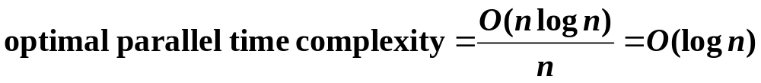
Potential Speedup
O(nlogn) optimal sequential sorting algorithm
Best we can expect based upon a sequential sorting algorithm using n processors is:

Slide 15


